Slide 1
COMP 2230
Week 7 - Monday

Slide 2
Last time
Halting problem
Cardinality
Countable and uncountable infinity
Started relations

Slide 3
Questions?

Slide 4
Assignment 3

Slide 5
Logical warmup
All but one of the numbers from 1 to 100 are read to you, one every 10 seconds, but in no particular order.
You have a good mind, but only a normal memory, and no means of recording information during the process.
How can you ensure you can figure out which number was not called out?

Slide 6
Relations

Slide 7
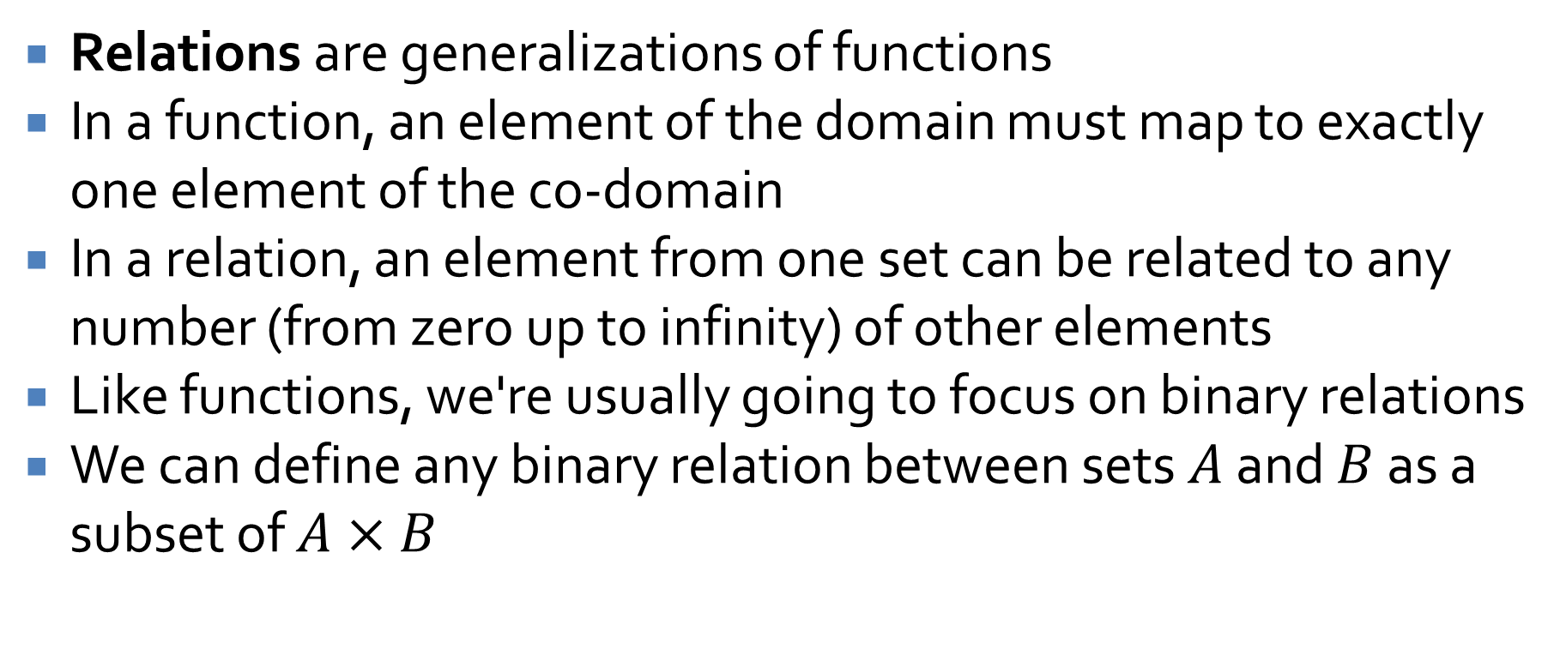
Relations
Relations are generalizations of functions
In a function, an element of the domain must map to exactly one element of the co-domain
In a relation, an element from one set can be related to any number (from zero up to infinity) of other elements
Like functions, we're usually going to focus on binary relations
We can define any binary relation between sets $A$ and $B$ as a subset of $A×B$

Slide 8
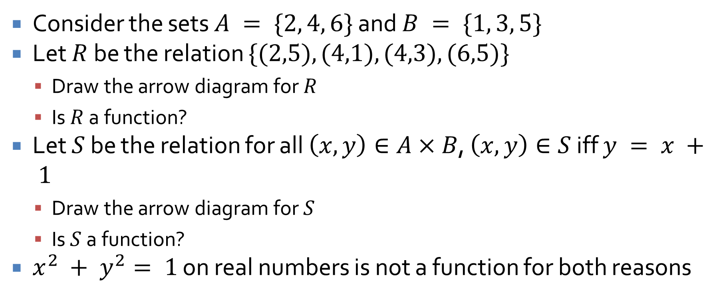
Function or not?
Consider the sets $A = \{2, 4, 6\}$ and $B = \{1, 3, 5\}$
Let $R$ be the relation $\{(2,5), (4,1), (4,3), (6,5)\}$
Draw the arrow diagram for $R$
Is $R$ a function?
Let $S$ be the relation for all $\left(x, y\right)∈A×B$, $\left(x, y\right)∈S$ iff $y = x + 1$
Draw the arrow diagram for $S$
Is $S$ a function?
$x^{2} + y^{2}= 1$ on real numbers is not a function for both reasons

Slide 9
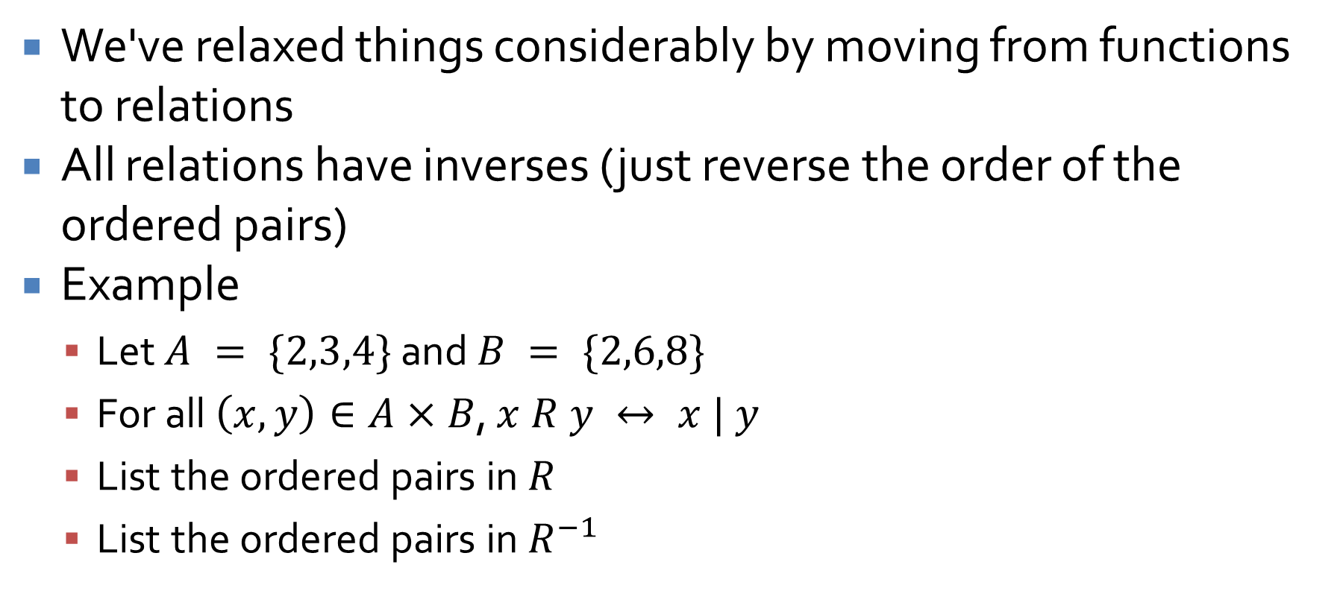
Inverses
We've relaxed things considerably by moving from functions to relations
All relations have inverses (just reverse the order of the ordered pairs)
Example
Let $A = \{2,3,4\}$ and $B = \{2,6,8\}$
For all $\left(x, y\right)∈A×B$, $x R y ↔ x | y$
List the ordered pairs in $R$
List the ordered pairs in $R^{−1}$

Slide 10
Directed graphs
A directed graph describes a relationship between nodes
One way to record a graph is as a matrix
We can also think of a directed graph as a relation from a set to itself
What's the relation for this directed graph?
a
b
c
d
e

Slide 11
Properties of Relations

Slide 12
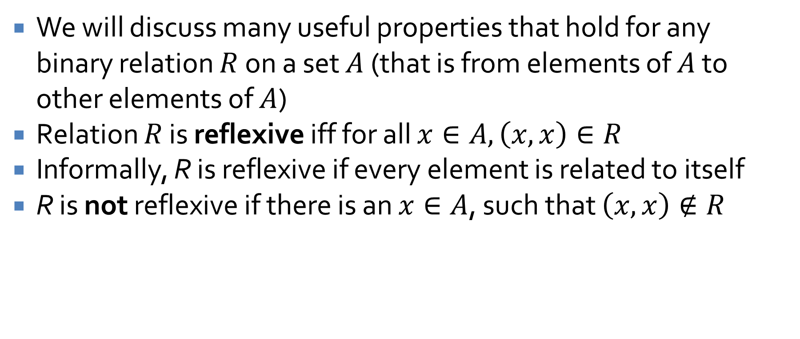
Reflexive
We will discuss many useful properties that hold for any binary relation $R$ on a set $A$ (that is from elements of $A$ to other elements of $A$)
Relation $R$ is reflexive iff for all $x∈A, \left(x, x\right)∈R$
Informally, R is reflexive if every element is related to itself
R is not reflexive if there is an $x∈A$, such that $\left(x, x\right)∉R$

Slide 13
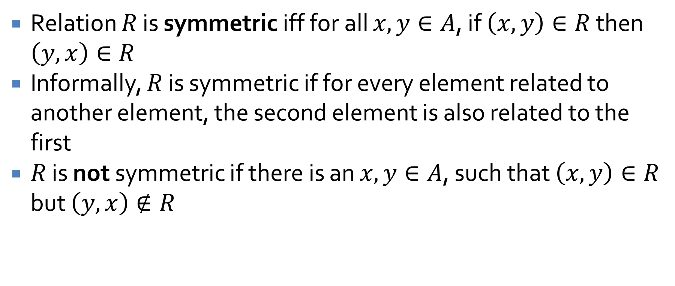
Symmetric
Relation $R$ is symmetric iff for all $x, y∈A$, if $\left(x, y\right)∈R$ then $\left(y, x\right)∈R$
Informally, $R$ is symmetric if for every element related to another element, the second element is also related to the first
$R$ is not symmetric if there is an $x, y∈A$, such that $\left(x, y\right)∈R$ but $\left(y, x\right)∉R$

Slide 14
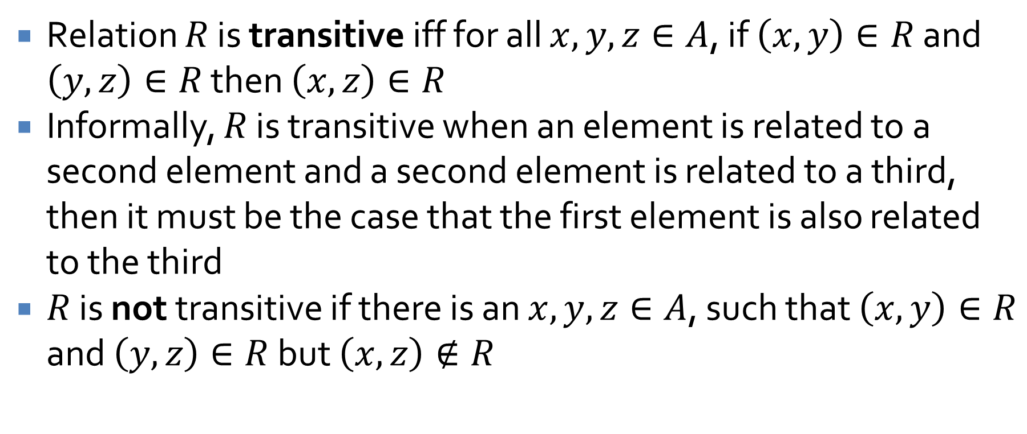
Transitive
Relation $R$ is transitive iff for all $x, y, z∈A$, if $\left(x, y\right)∈R$ and $\left(y, z\right)∈R$ then $\left(x, z\right)∈R$
Informally, $R$ is transitive when an element is related to a second element and a second element is related to a third, then it must be the case that the first element is also related to the third
$R$ is not transitive if there is an $x, y, z∈A$, such that $\left(x, y\right)∈R$ and $\left(y, z\right)∈R$ but $\left(x, z\right)∉R$

Slide 15
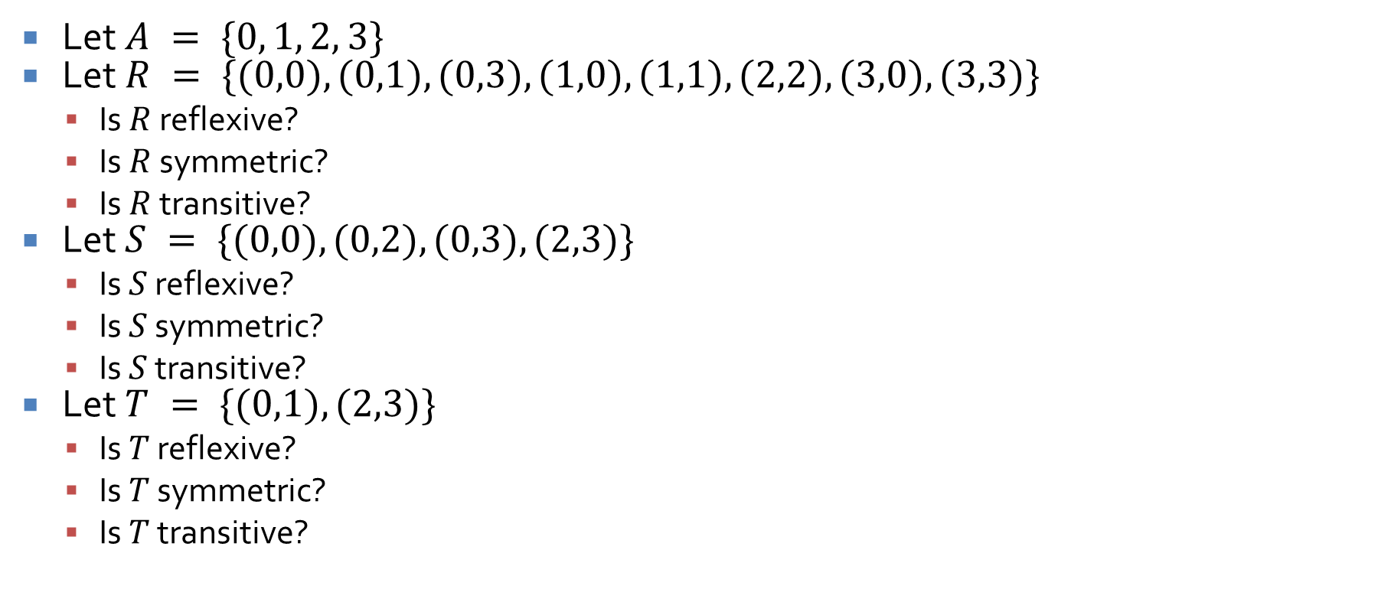
Examples
Let $A = \{0, 1, 2, 3\}$
Let $R = \{(0,0), (0,1), (0,3), (1,0), (1,1), (2,2), (3,0), (3,3)\}$
Is $R$ reflexive?
Is $R$ symmetric?
Is $R$ transitive?
Let $S = \{(0,0), (0,2), (0,3), (2,3)\}$
Is $S$ reflexive?
Is $S$ symmetric?
Is $S$ transitive?
Let $T = \{(0,1), (2,3)\}$
Is $T$ reflexive?
Is $T$ symmetric?
Is $T$ transitive?

Slide 16
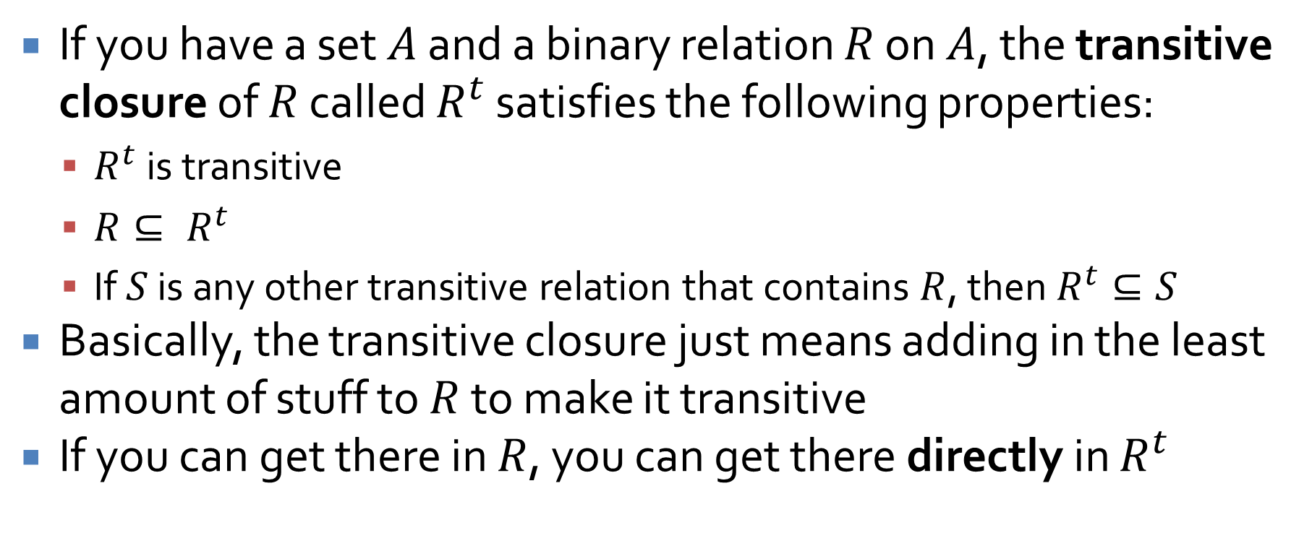
Transitive closures
If you have a set $A$ and a binary relation $R$ on $A$, the transitive closure of $R$ called $R^{t}$ satisfies the following properties:
$R^{t}$ is transitive
$R⊆ R^{t}$
If $S$ is any other transitive relation that contains $R$, then $R^{t}⊆S$
Basically, the transitive closure just means adding in the least amount of stuff to $R$ to make it transitive
If you can get there in $R$, you can get there directly in $R^{t}$

Slide 17

Transitive closure example
Let $A = \{0, 1, 2, 3\}$
Let $R = \{(0,1), (1,2), (2,3)\}$
Is $R$ transitive?
Then, find the transitive closure of $R$

Slide 18
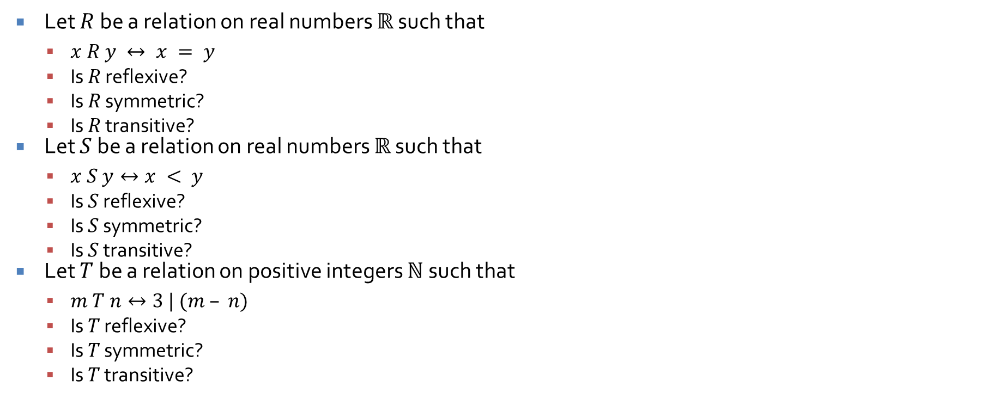
Examples on real sets
Let $R$ be a relation on real numbers $ℝ$ such that
$x R y ↔ x = y$
Is $R$ reflexive?
Is $R$ symmetric?
Is $R$ transitive?
Let $S$ be a relation on real numbers $ℝ$ such that
$x S y↔x < y$
Is $S$ reflexive?
Is $S$ symmetric?
Is $S$ transitive?
Let $T$ be a relation on positive integers $ℕ$ such that
$m T n↔3 | (m – n)$
Is $T$ reflexive?
Is $T$ symmetric?
Is $T$ transitive?

Slide 19
Equivalence Relations

Slide 20
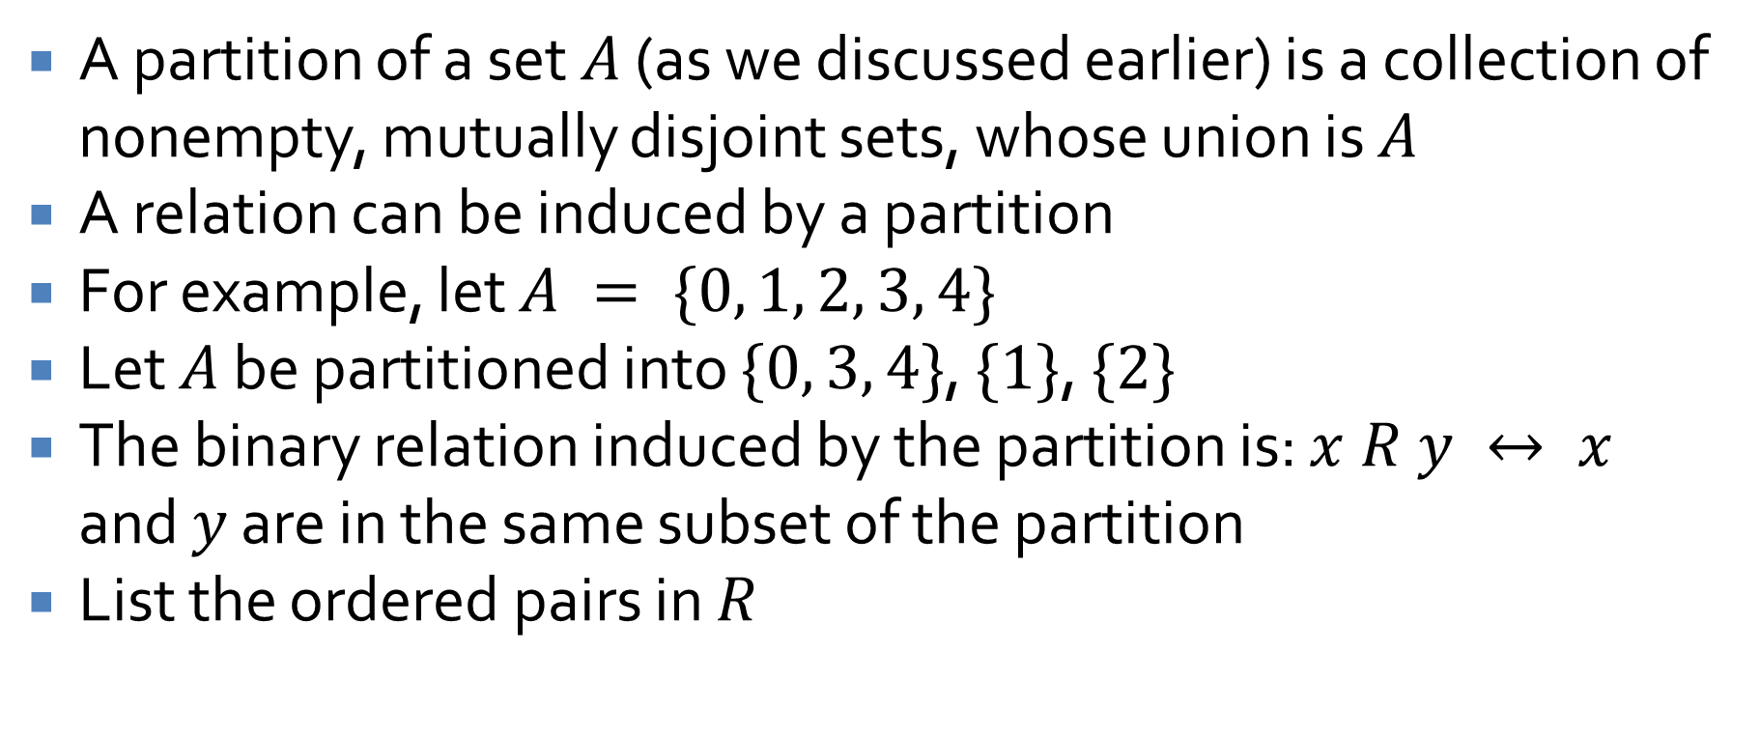
Partitions
A partition of a set $A$ (as we discussed earlier) is a collection of nonempty, mutually disjoint sets, whose union is $A$
A relation can be induced by a partition
For example, let $A = \{0, 1, 2, 3, 4\}$
Let $A$ be partitioned into $\{0, 3, 4\}$, $\{1\}$, $\{2\}$
The binary relation induced by the partition is: $x R y ↔ x$ and $y$ are in the same subset of the partition
List the ordered pairs in $R$

Slide 21
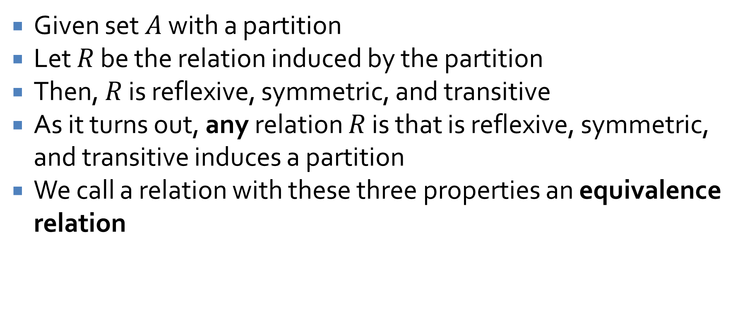
Equivalence relations
Given set $A$ with a partition
Let $R$ be the relation induced by the partition
Then, $R$ is reflexive, symmetric, and transitive
As it turns out, any relation $R$ is that is reflexive, symmetric, and transitive induces a partition
We call a relation with these three properties an equivalence relation

Slide 22
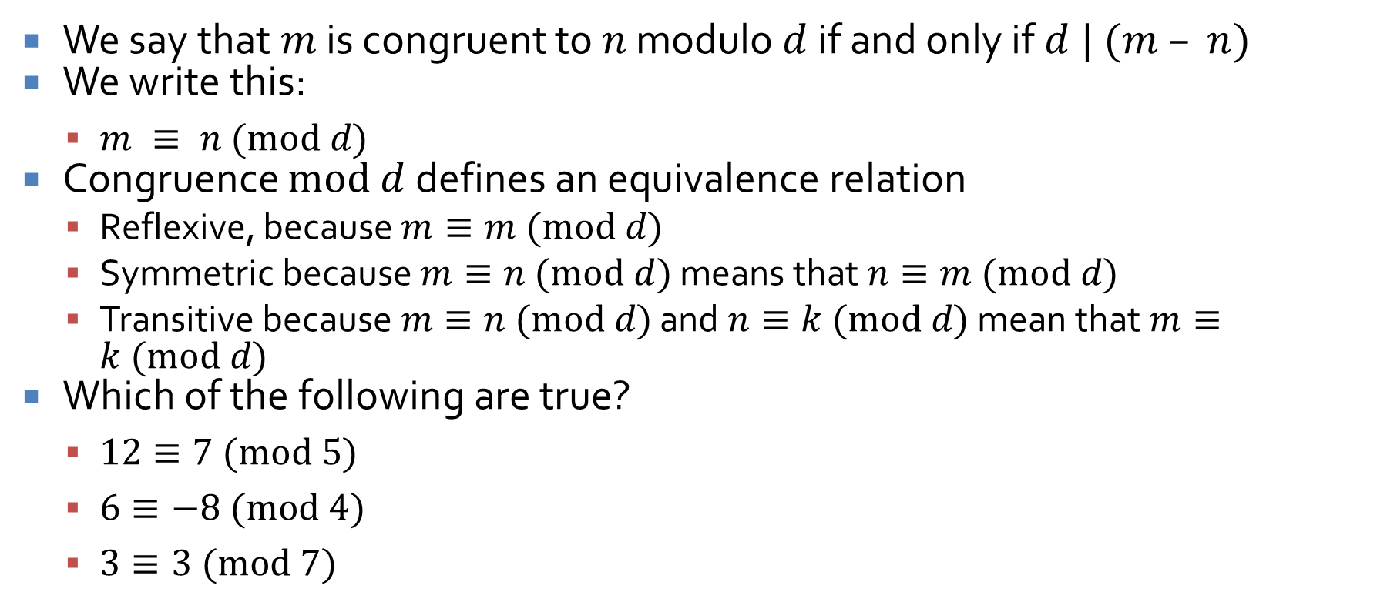
Congruences
We say that $m$ is congruent to $n$ modulo $d$ if and only if $d | (m – n)$
We write this:
$m ≡ n (mod d)$
Congruence $mod d$ defines an equivalence relation
Reflexive, because $m≡m (mod d)$
Symmetric because $m≡n (mod d)$ means that $n≡m (mod d)$
Transitive because $m≡n (mod d)$ and $n≡k (mod d)$ mean that $m≡k (mod d)$
Which of the following are true?
$12≡7 (mod 5)$
$6≡−8 (mod 4)$
$3≡3 (mod 7)$

Slide 23
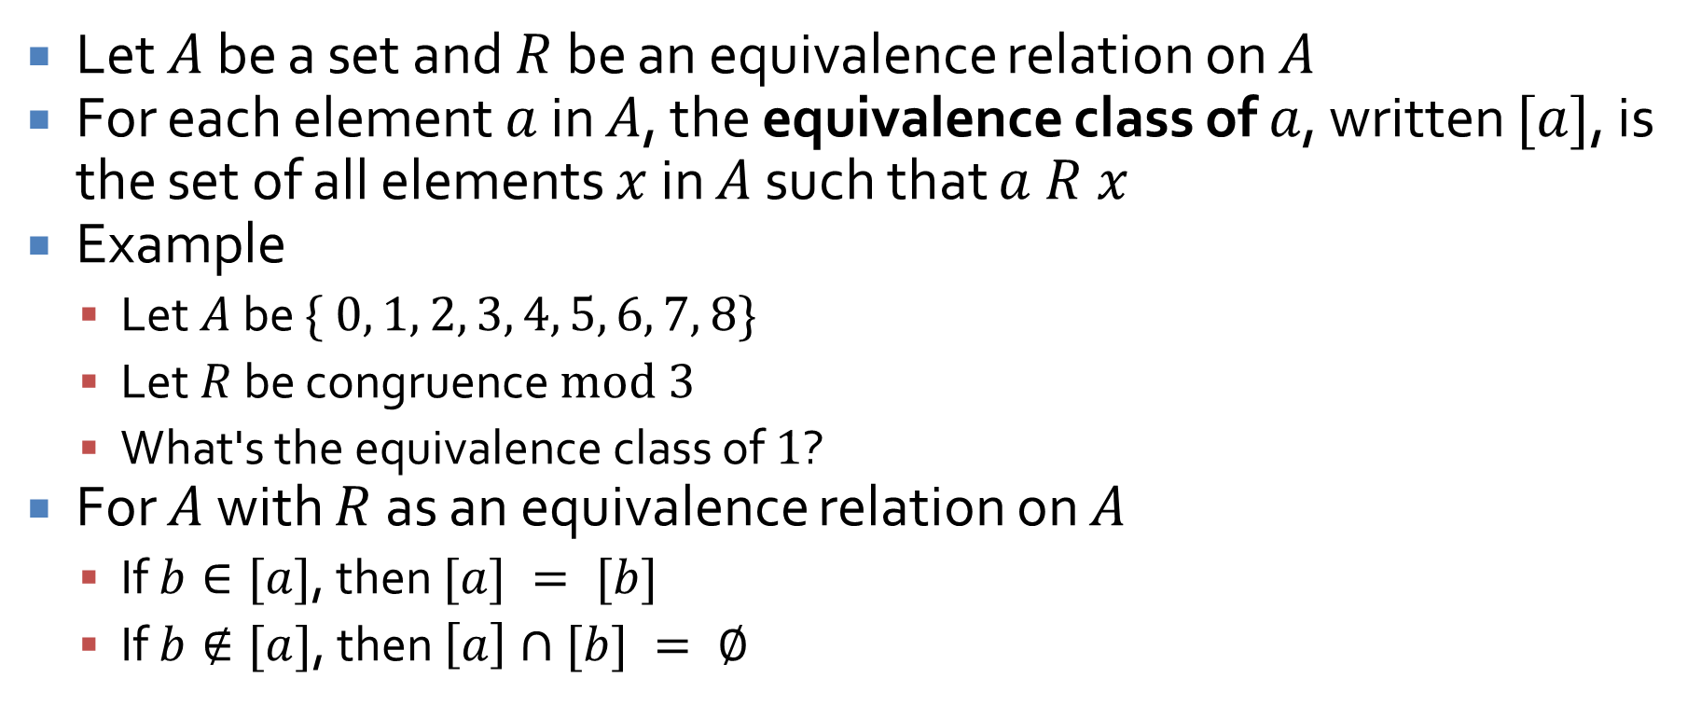
Equivalence classes
Let $A$ be a set and $R$ be an equivalence relation on $A$
For each element $a$ in $A$, the equivalence class of $a$, written $[a]$, is the set of all elements $x$ in $A$ such that $a R x$
Example
Let $A$ be $\{ 0, 1, 2, 3, 4, 5, 6, 7, 8\}$
Let $R$ be congruence $mod 3$
What's the equivalence class of $1$?
For $A$ with $R$ as an equivalence relation on $A$
If $b∈[a]$, then $[a] = [b]$
If $b∉[a]$, then $\left[a\right]∩[b] = ∅$

Slide 24
Ticket Out the Door

Slide 25
Upcoming

Slide 26
Next time…
Finish equivalence relations
Modular arithmetic
Partial orders
Review for Exam 2

Slide 27
Reminders
Work on Assignment 3
Due Friday
No office hours on Wednesday, Thursday, or Friday
No class on Friday
Read 8.4 and 8.5

